Slide 1
Just-in-Time Provisioning for Cyber Foraging
6/27/2013
Kiryong Ha∗, Padmanabhan Pillai†, Wolfgang Richter∗ Yoshihisa Abe∗, Mahadev Satyanarayanan∗
*Carnegie Mellon University, †Intel Labs

Slide 2
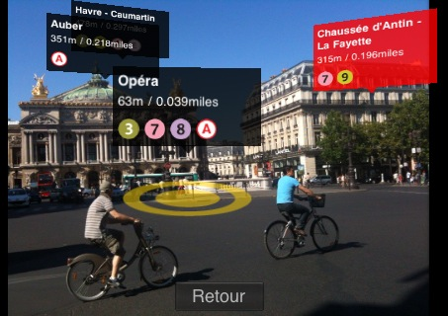
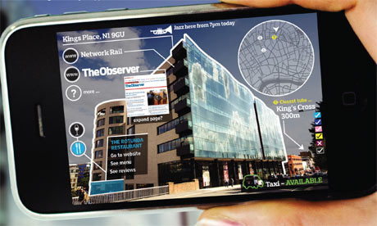
Cloud Offloading
Rich, interactive applications are emerging in mobile context
Apple’s Siri, AR apps..
Wearable devices push this trend even more!
Cloud offloading
These applications are too expensive to run on clients alone!
Offload computation to a back-end server at cloud
MAUI (Mobisys ‘10), Odessa (MobiSys ‘11), COMET (OSDI ‘12)
Today’s cloud is a suboptimal place; high latency and limited bandwidth
[intro][background][optimization][result][conclusion]

Slide 3
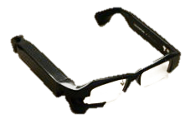
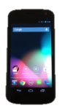
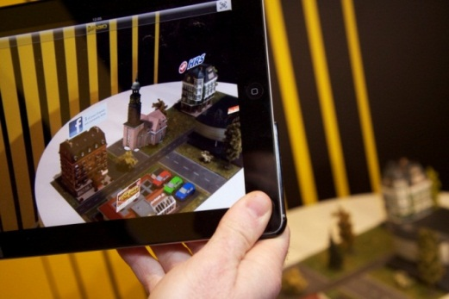
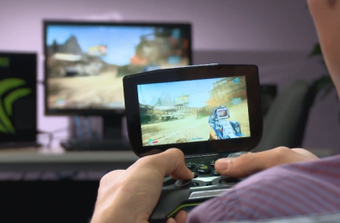
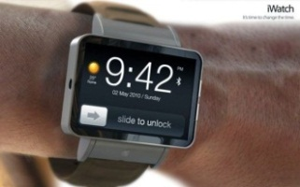
Cloudlet as a Nearby Offload Site
Cloudlet: an nearby offloading site dispersed at the edges of the Internet
→ Let’s bring the cloud closer!
WAN
Cloud
Cloudlet
Nokia Siemens Networks & IBM
Nvidia
How to launch a custom back-end server at an arbitrary edge?
[intro][background][optimization][result][conclusion]

Slide 4
Just-in-Time Provisioning
Challenges in provisioning
Support widest range of user customization including OS, language, and library
Strong isolation between untrusted computations
Access control, metering, dynamic resource management, …
→ VM (virtual machine) cleanly encapsulates this complexity, but delays provisioning
A traveler wants to use natural language translation with speaker-trained voice recognition
Cloudlet
GOAL : Just-in-time provisioning of a custom VM for offloading
[intro][background][optimization][result][conclusion]

Slide 5
VM Synthesis
VM Synthesis: dividing a custom VM into two pieces
Base VM: Vanilla OS that contains kernel and basic libraries
VM overlay: A binary patch that contains customized parts
Customized VM (Launch VM)
Base VM
Binary delta
VM overlay
Base Disk
Modified Disk
Diff Disk
Overlay Disk
–
=
Compress
Base Memory
Modified Memory
Diff Memory
Overlay Memory
[intro][background][optimization][result][conclusion]

Slide 6
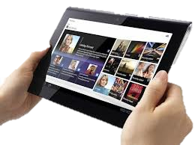
VM Synthesis
Steps for VM synthesis
User
Cloudlet
VM overlay
Synthesize VM
- Decompress
- Apply delta
with pre-populated base VM
Resume launch VM
Backend
Server in VM
ready
Offload operations
[intro][background][optimization][result][conclusion]

Slide 7
VM Synthesis – Baseline Performance
Performance measurement with rich, interactive applications
Base VM: Windows 7 and Ubuntu 12.04
8GB base disk and 1GB base memory
Application | Install size (MB) | Overlay Size |  | Synthesis time (s)
 |  | Disk (MB) | Memory (MB)
OBJECT | 39.5 | 92.8 | 113.3 | 62.8
FACE | 8.3 | 21.8 | 99.2 | 37.0
SPEECH | 64.8 | 106.2 | 111.5 | 63.0
AR | 97.5 | 192.3 | 287.9 | 140.2
FLUID | 0.5 | 1.8 | 14.1 | 7.3
802.11n WiFi (average 38 Mbps)
Reduce VM synthesis time as little as 10 seconds!
[intro][background][optimization][result][conclusion]

Slide 8
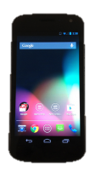
Overview of Optimizations
Minimize VM overlay size
Accelerate VM synthesis
Creating VM overlay (offline)
VM synthesis (runtime)
transfer
VM
overlay
Launch VM
Deduplication
Pipelining
Reducing Semantic Gaps
Early Start
file save
Launch VM
VM
overlay
new site
[intro][background][optimization][result][conclusion]

Slide 9
1.1 Deduplication
Approach
Remove redundancy in the VM overlay
Sources of redundancy
Between base VM and VM overlay
Shared library copied from base disk
Loaded executable binary from base disk
Between VM overlay’s memory and disk
Page cache, disk I/O buffer
[intro][background][optimization][result][conclusion]

Slide 10
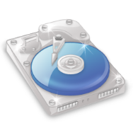
1.1 Deduplication
Get the list of modified (disk, memory) chunks at the customized VM
Perform deduplication to reduce this list to a minimum
Compare to 1) base disk, 2) base memory, 3) other chunks within itself
Compare between modified memory and modified disk
Offline operation!
type | offset | reference | Data or pointer
mem | 4096 | unique | data
mem | 16384 | self
mem | 20480 | Base disk
mem | 28672 | Base memory
mem | 36864 | unique | data
…
disk | 0 | unique | data
disk | 16384 | overlay mem
type | offset | Data
mem | 4096 | data
mem | 16384 | data
mem | 20480 | data
mem | 28672 | data
mem | 36864 | data
…
disk | 0 | data
disk | 16384 | data
Base VM
<Modified chunks>
<Overlay chunks>
[intro][background][optimization][result][conclusion]

Slide 11
1.2 Reducing Semantic Gaps
VM is a strong black box
It ensures isolation between the host, the guest, and other guests
But, VMM cannot interpret high-level information of memory and disk
Example: Download 100 MB file over network and delete it
Ideally, it should result in no increase in VM overlay size
However, VMM will see 200 MB of modifications:
100 MB of changed disk state
100 MB of changed memory state (in-memory I/O buffer cache)
→ Let’s include only the state that actually matters to the guest OS
[intro][background][optimization][result][conclusion]

Slide 12
1.2 Reducing Semantic Gaps – Disk
Disk semantic gap between VMM and Guest OS
File deletion operations only mark blocks as deleted, without discarding the contents
VMM can’t distinguish between deleted and valid contents
Implementation: TRIM support
ATA standard originally designed to improve SSD’s overwrite performance
Allows an OS to inform a SSD which blocks of data are no longer in use
TRIM support at QEMU
Modify QEMU’s IDE emulation to enable TRIM
Guest OS agnostic: Linux (kernel 2.6.28), Mac OS X (June 2011), Window 7
time:1349399899.473041, sector_number:5244928, sector_size:16
time:1349399899.473046, sector_number:5375998, sector_size:3394
...
[intro][background][optimization][result][conclusion]

Slide 13
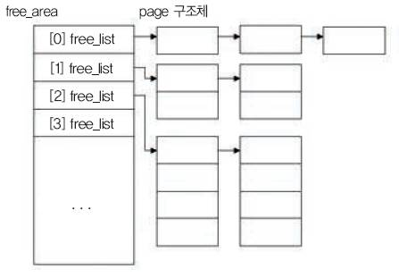
1.2 Reducing Semantic Gaps – Memory
Memory semantic gap between VMM and Guest OS
Released memory is moved to the OS’s free page list, but is still filled with garbage
VMM can’t distinguish between valid memory and garbage data
Approach
No way to communicate free page information between the guest and VMM → scan memory snapshot
Implementation
Insert a small agent at guest OS
Get memory address of the kernel data structure that has the free memory list
Need guest help : currently, works only in Linux
Extract free memory pages by traversing the data structure
[intro][background][optimization][result][conclusion]

Slide 14
VM Overlay Size
Deduplication optimization reduces the VM overlay size to 44%
Using semantic knowledge reduces the VM overlay size to 55%
Both applied together, overlay size is reduced to 28% of baseline
[intro][background][optimization][result][conclusion]

Slide 15
Overview of Optimizations
Minimize VM overlay size
Accelerate VM synthesis
Creating VM overlay (offline)
VM synthesis (runtime)
transfer
VM
overlay
Launch VM
Deduplication
Pipelining
Reducing Semantic Gaps
Early Start
file save
Launch VM
VM
overlay
new site
[intro][background][optimization][result][conclusion]

Slide 16
2.1 Pipelining
Steps for VM synthesis
① Transfer VM overlay ② Decompress ③ Apply delta
<Sequential>
Memory Transfer
Memory
Decomp
Memory Delta
Disk Transfer
Disk
Decomp
Disk Delta
VM Resume
<Pipelined>
Memory Transfer
Disk Transfer
VM Resume
Memory
Decomp
Disk
Decomp
Memory Delta
Disk Delta
Complexities in removing inter-dependencies among blobs
[intro][background][optimization][result][conclusion]

Slide 17
2.2 Early Start
Approach
From user’s perspective, first response time of offloading is most important
Starting VM even before finishing VM synthesis?
Do not wait until VM synthesis finishes, but start offloading immediately and process the request while synthesis is ongoing
[intro][background][optimization][result][conclusion]

Slide 18
2.2 Early Start
Implementation
Reorder the chunks in estimated access-order
Break the ordered overlay into smaller segments for demand fetching
Start the VM and begin streaming the segments in order, but also allow out-of-order demand fetches to preempt the original ordering
[intro][background][optimization][result][conclusion]

Slide 19
Diagram of Early Start
Mobile
Application
VM (back-end server)
Synthesis client
Offload Request
VMM (KVM)
Synthesis
Server
FUSE
Transfer VM overlay
Disk
Memory
Base Disk
Base Memory
Overlay Disk
Overlay Memory
Filling overlay
[intro][background][optimization][result][conclusion]

Slide 20
Review of Optimizations
Creating VM overlay (offline)
VM synthesis (runtime)
transfer
VM
overlay
Launch VM
Deduplication
Pipelining
Reducing Semantic Gaps
Early Start
file save
Launch VM
VM
overlay
new site
[intro][background][optimization][result][conclusion]

Slide 21
First-response time compared to baseline
10
* Chunks are ordered with segment size of 1 MB
Time between starting VM synthesis and receiving the first offload result
It is faster than remote installation maintaining strong guarantees
Except AR, we can get first-response within 10 seconds (up to 8x improvement)
[intro][background][optimization][result][conclusion]

Slide 22
Future work & Conclusion
Future work
Open source : http://github.com/cmusatyalab/elijah-cloudlet
Integrate with OpenStack (open-source cloud computing platform)
Conclusion
Cloudlets support resource-intensive and interactive mobile apps
Physical dispersion of cloudlets makes their provisioning a challenge
We have shown how cloudlets can be rapidly provisioned
[intro][background][optimization][result][conclusion]

