Slide 1


Gabriel: Towards
Wearable Cognitive Assistance
Kiryong Ha, Zhuo Chen, Wenlu Hu, Wolfgang Richter,
Padmanabhan Pillai, and Mahadev Satyanarayanan

Slide 2

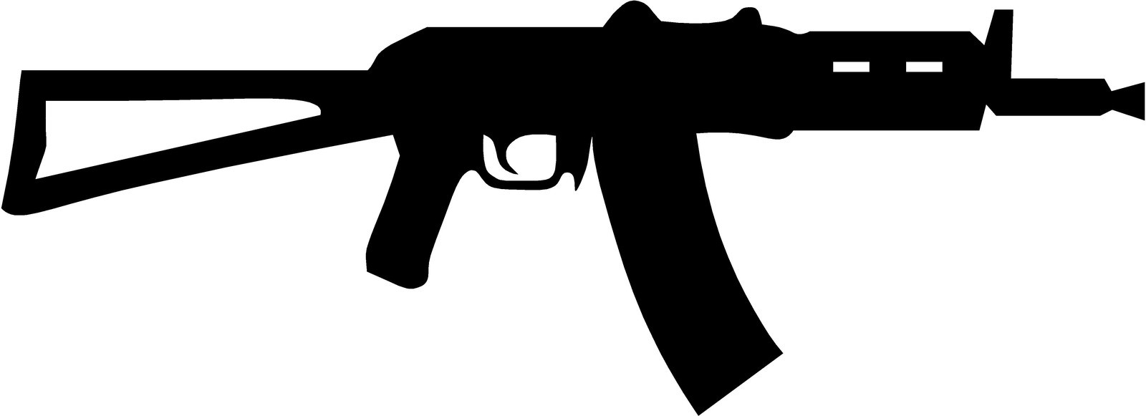

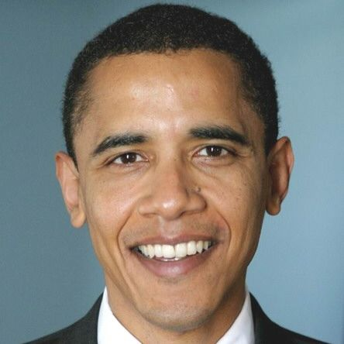

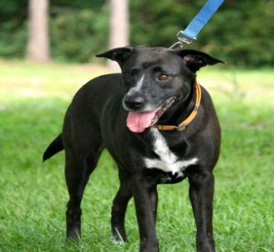

Cognitive Decline
survivors of stroke
mild cognitive impairment
  One-month delay in nursing home
  admissions saves $1,000,000,000+/year
20,000,000+ Americans affected
Alzheimer’s disease
traumatic brain injury
Ron
Faces
Text
Daily Routine

Slide 3

Can Wearable Technology Help?
Continuously capture,
interpret,
and
give guidance
System Architecture

Slide 4
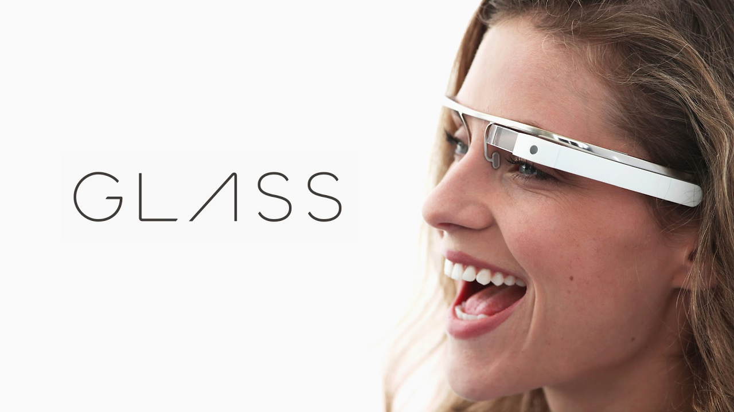
“Barack is saying hello to you”
“Please stop and check traffic”
“Your dog wants to go out for a walk”

Slide 5
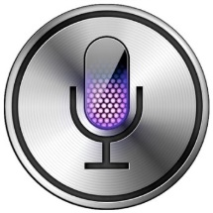

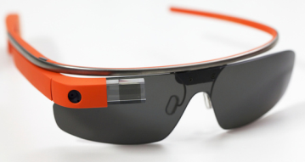
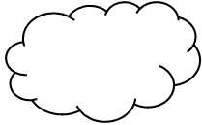
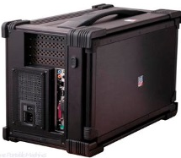
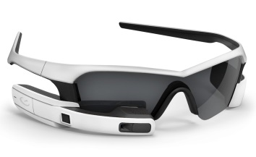
Why Today?
Advances in 3 Independent Arenas
Algorithms
Wearable Hardware
Offloading Technology

Slide 6
Challenges – Architecture
Crisp Interactive Response
Graceful Degradation of Services
Coarse-grain Parallelism

Slide 7

C1. Crisp Interactive Response
Humans are fast and sensitive
Face exists?
<700ms
Voice Phrases?
~400ms
Whose face?
~500ms
Satellite Phone?
ANNOYING!
Goal: Latency of infrastructure = tens of millisecond

Slide 8




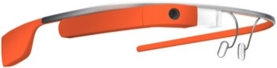
S1. Crisp Interactive Response
Choice 1: standalone apps
Choice 2: offload to cloud
Choice 3: offload to cloudlets
~74ms
WAN
Distant
Resources
in Cloud
Glass Device
Wi-Fi
LAN
<10ms
Nearby Cloudlet

Slide 9
Exp. – Cloudlet Shortens Latency
Offloading vs. Standalone (OCR)
Offloading saves latency and energy
Metric | Standalone | With Offload
Per-image speed (s) | 10.49 | 1.28
Per-image energy(J) | 12.84 | 1.14
Cloudlet vs. Cloud (Augmented Reality)
Cloudlet shortens response time

Slide 10
C2. Graceful Degradation of Services
What if offloading impossible?
Situation 1: No cloudlet
Situation 2: No network
?
Distant
Resources
in Cloud
Glass Device
Wi-Fi
WAN
LAN
?
Nearby Cloudlet
Goal: still work during failures – with performance drop

Slide 11
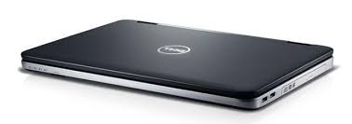
S2. Graceful Degradation of Services
Use fallback resources
No cloudlet – offload to cloud
No network – offload to carry-on device
?
Distant
Resources
in Cloud
Glass Device
Wi-Fi
WAN
Wi-Fi or Bluetooth
LAN
?
On-body Offload Device
Nearby Cloudlet
Application-specific fidelity vs. Crispness & battery life

Slide 12

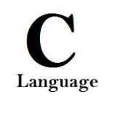






C3. Coarse-grain Parallelism
Don’t reinvent the wheel
Face recognition
Object detection
Activity inference
OCR ……
Goal: reuse existing work, but…
Programming languages are different
Runtime systems are different (different OSes, closed-source, etc.)

Slide 13



S3. Coarse-grain Parallelism
VM Ensemble and PubSub Backbone
Virtual Machine
Proxy
Core Algorithm Logic
Dataset
Config

Slide 14
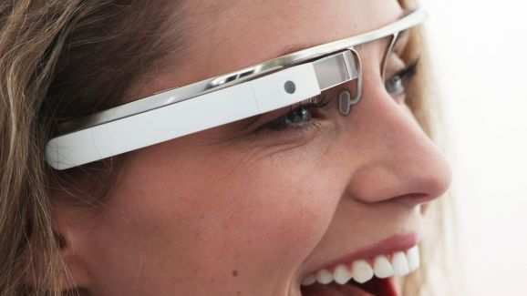
S3. Coarse-grain Parallelism
VM Ensemble and PubSub Backbone
Cognitive VMs
Control VM
Cognitive Engine 1
e.g. Face recognition
Wi-Fi
Glass Device
Video/Acc/…
sensor streams
DeviceComm
PubSub
Cognitive Engine 2
UPnP
Cognitive Engine 3
...
User assistance
User Guidance VM
Sensor flows
Cognitive flows
Cognitive Engine n
VM boundary
Cloudlet

Slide 15
S3. Coarse-grain Parallelism
VM Ensemble and PubSub Backbone
Wi-Fi
Cognitive VMs
Control VM
Cognitive Engine 1
e.g. Face recognition
Wi-Fi
Context Inference
Sensor control
Glass Device
Video/Acc/…
sensor streams
DeviceComm
PubSub
Cognitive Engine 2
UPnP
Cognitive Engine 3
...
User assistance
User Guidance VM
Sensor flows
Cognitive flows
Cognitive Engine n
VM boundary
Cloudlet

Slide 16
Exp. – Gabriel Overhead
Gabriel Latency: ~50ms
Gabriel Overhead: ~3ms
Echos every image
Dummy Cognitive Engine
No VM, echos from host

Slide 17
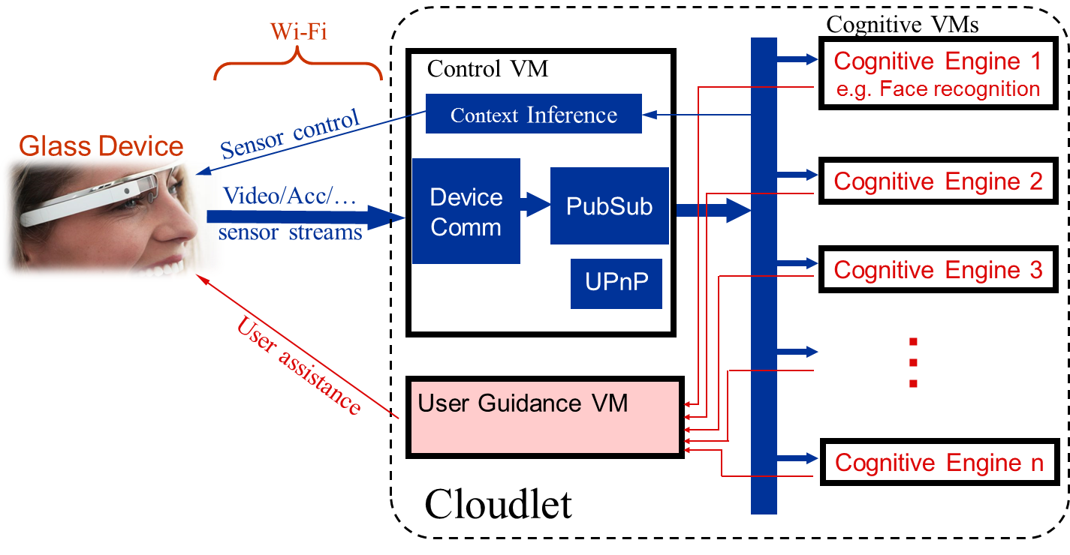
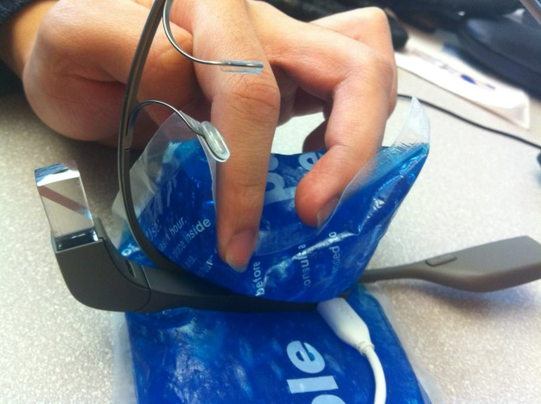
Prototype
Back-end Server
GDK Preview
TCP Connection
Speech Guidance
Ice pack to cool down Glass

Slide 18
Prototype
Back-end Server
Cloudlet: 4 advanced desktop machines
Running OpenStack – Virtualized Cloud Computing Platform

Slide 19
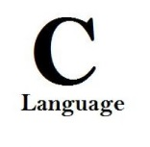


Prototype
Cognitive Engines
Face Recognition
Object Recognition (1. MOPED 2. STF )
OCR (1. Tesseract 2. VeryPDF )
Motion Classifier
Augmented Reality
Activity Detection
Commercial Product
Based on Accelerometer

Slide 20
Exp. – Full System Performance
Cognitive Engines are slower
Cognitive Engine | FPS | Response time (ms) |  |  |  |  | Glass Life
 |  | 1% | 10% | 50% | 90% | 99%
Face Recognition | 4.4 | 196 | 389 | 659 | 929 | 1175 | ~1 hour
Object (MOPED) | 1.6 | 877 | 962 | 1207 | 1647 | 2118
Object (STF) | 0.4 | 4202 | 4371 | 4609 | 5055 | 5684
OCR (Open) | 14.4 | 29 | 41 | 87 | 147 | 511
OCR (Comm) | 2.3 | 394 | 435 | 522 | 653 | 1021
Motion Classifier | 14.0 | 126 | 152 | 199 | 260 | 649
Augmented Reality | 14.1 | 48 | 72 | 126 | 192 | 498
Gabriel architecture allows easy upgrade.

Slide 21
Exp. – Full System Performance
Cognitive Engines require different FPS
Cognitive Engine | FPS | Response time (ms) |  |  |  |  | Glass Life
 |  | 1% | 10% | 50% | 90% | 99%
Face Recognition | 4.4 | 196 | 389 | 659 | 929 | 1175 | ~1 hour
Object (MOPED) | 1.6 | 877 | 962 | 1207 | 1647 | 2118
Object (STF) | 0.4 | 4202 | 4371 | 4609 | 5055 | 5684
OCR (Open) | 14.4 | 29 | 41 | 87 | 147 | 511
OCR (Comm) | 2.3 | 394 | 435 | 522 | 653 | 1021
Motion Classifier | 14.0 | 126 | 152 | 199 | 260 | 649
Augmented Reality | 14.1 | 48 | 72 | 126 | 192 | 498
Gabriel uses two-level token-based flow control

Slide 22
Control VM
Processed
Items Count
M
A
X
Glass Device
•••
sensor
Cognitive VM
drop
drop
• • •
tokens
a
b
Cognitive VM
a > b?
Drop
Count
drop
yes
no
sum
sensor data
counts

Slide 23
More in the Paper
Token-based ﬂow control improves response time a lot
Gabriel supports multi-VM parallelism
Tradeoff between ﬁdelity reduction and crisp user interaction

Slide 24
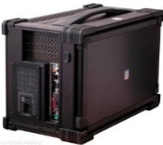
Conclusion & Future Work
Gabriel: low-latency, flexible architecture
Speed improvement needed
Algorithms
Wearable Hardware
Offloading Technology
Longer battery, better thermal dissipation
Cloudlets are helpful, need good biz. model

Slide 25
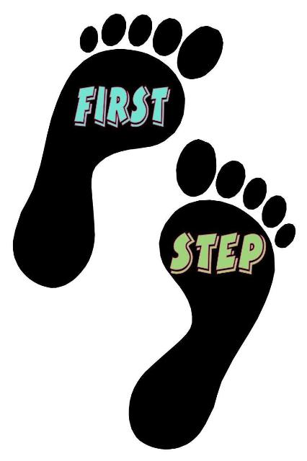
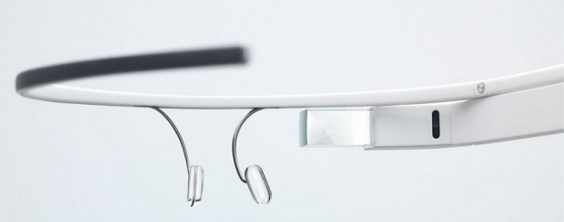

Gabriel:
Towards
Wearable
Cognitive Assistance
Contact: Kiryong Ha (krha@cmu.edu) Zhuo Chen(zhuoc@cs.cmu.edu)

