Slide 1
The Impact of Mobile Multimedia
Applications on Data Center Consolidation
Kiryong Ha∗, Padmanabhan Pillai†, Grace Lewis‡, Soumya Simanta‡, Sarah Clinch§, Nigel Davies§, and Mahadev Satyanarayanan∗
∗Carnegie Mellon University, †Intel Labs, ‡CMU-SEI, §Lancaster University
3/27/2013
Notes:
Foot note for reference

Slide 2
Consolidation is the key to Cloud computing
Cloud computing achieves economies of scale by consolidating resources
It lower the marginal cost of operation and management
Amazons EC2 spans the entire planet with 7 data centers
Large separation between a mobile device and its cloud
High latency in end-to-end communication
Challenges for latency sensitive applications
From http://gcn.com/articles/2012/10/26/agency-data-centers-idc-report.aspx
Notes:
These economies of scale evaporate if too many data center have to be maintained and administered.

Slide 3
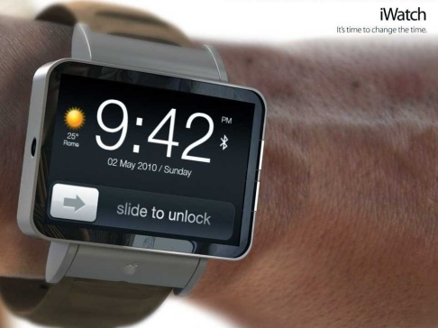
Emerging Mobile Applications
A new class of applications using video/voice in mobile context
Apple’s Siri, Augmented reality applications
Many of these are interactive as well as resource-intensive
Beyond the processing and storage limits of mobile device
Use Cloud to offload execution
Wearable Devices like Google Glass will push this trend more
From http://www.google.com/glass/start/ and http://www.flickr.com/photos/x1brett/4600461689/

Slide 4
Questions
Do we really need to offload?
What’s the effect of Cloud location?
In situation where public Clouds are inadequate, what would be an alternative Cloud architecture?
Notes:
In this talk, I’d like to find the answers for these question.
In situations where public clouds are inadequate, what would be an alternative offload architecture?

Slide 5
Applications Studied
Applications
Resource intensive and latency sensitive applications
Application | Input | Output | Execution Environment
Face Recognition | Image | Name and position of a detected face | OpenCV on Windows
Speech Recognition | Audio | Words in plain text format | Java on Linux
Object Recognition | Image | Names and positions of found objects | C++ on Linux
Augmented Reality | Image | Name (information) of recognized landmark | OpenCV & Intel IPP on Windows
Fluid Simulation | Acc data | Location and pressure of simulated particles | C++ on Linux
Notes:
Fluid Simulation:
It physically models the motion of imaginary fluid using the accelerometer data from a mobile device. For example, it can show liquid sloshing around in a container.
We note that the computational structure of this application is representative of many other interactive application particularly “real-time” games.

Slide 6
1. Do we need to offload?
Extremes of resource demands
It may appear that today’s smartphone are already powerful enough
Built-in support for face detection in Android SDK
But, computation varies dramatically depend on operational conditions
Face recognition
Increasing number of possible faces,
Reducing the constraints on the observation conditions
Notes:
At first glance, it may appear that today’s smartphone are already powerful enough to support mobile multimedia applications.
For example, Android SDK provides built-in API for face detection.
However, upon closer examination, the situation is much complex. Think about computer vision algorithms. Their computational requirements vary drastically depending on the operational conditions. For example with face recognition, just two simple changes make a huge difference. Increasing the number of possible faces from just a few close friends to the entire set of people in the building, and reducing the constraints on the observation conditions by allowing faces to be at arbitrary viewpoints from the observer.

Slide 7
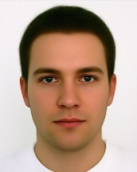
1. Do we need to offload?
High variability of execution time
Speech recognition
Execution time increases with the number of recognized words
FACE recognition
Execution time varies depends on the contents of images
 | no words recognized | 1-5 words recognized | 6-22 words recognized
Measured average time | 0.057 s | 1.04 s | 4.08 s
Image with single big face | Image with no face
0.30 s | 3.92 s
* Tested with a netbook as a mobile device
Notes:
To illustrate the great variability of execution times, we perform a set of experiments using two of the applications discussed earlier.

Slide 8
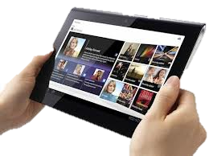
1. Do we need to offload?
Improvement from Cloud offloading
Though variability still exists, the absolute response times are improved
 | No Cloud |  | With Cloud
 | median | 99% | median | 99%
Speech (500 requests) | 1.22 s | 6.69 s | 0.23 s | 1.25 s
FACE (300 requests) | 0.42 s | 4.12 s | 0.16 s | 1.47 s
* We used Amazon EC2 for SPEECH and private Cloud for FACE.
** We used netbook as a mobile device.
Notes:
Transition “clearly we do need offload”

Slide 9
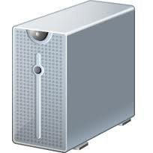
2. Effects of Cloud location
Experiment setup
Mobile (No offloading) : Local execution within mobile device
Cloud : Offload to Cloud (Amazon EC2)
4 locations: US-East, US-West, EU, Asia
1WiFi (One hop) : Offload to nearby compute resource
802.11n
1WiFi
Xeon E5320 @1.86 GHz
KVM with 4 cores, 4 GB RAM
Mobile Device
Dell Latitude 2120(netbook)
Intel Atom N550 @1.5 Ghz 4 cores, 2GB RAM
Cloud
Amazon X-large instance
20 EC2 computing unit
8 virtual cores, 7GB RAM
Fast mobile/Cloud and a slow Cloudlet configuration
1 EC2 Compute Unit ≈ 1.0-1.2 GHz 2007 Xeon processor
Notes:
To precisely quantify the benefit of cloud offloading and its effect depending on cloud location, we compared six cases.
First, no offloading, labeled “mobile”, runs the application entirely on the mobile device, so Cloud connectivity is irrelevant.
In other four cases, the resource-intensive part done at Amazon EC2 server and mobile device waits until it receives the result.
The last case, labeled 1WiFi, corresponds to the theoretical best-case for data center location. This is exactly one WiFi hop away from a mobile device.
This figure compares the hardware configuration used in our experiment. For mobile device, we used a netbook as a surrogate of futuristic mobile device.
For 1WiFi, we used a six-year old machine. The choice of this near-obsolete machine is deliberate. By comparing it against a fast mobile device and fast EC2 cloud instances, we have stacked the deck against 1WiFi. Therefore, any wins in 1WifFi in terms of performance should be considered quite meaningful.

Slide 10
2. Effects of Cloud location
Network measurement
Average RTT from 260 global vantage points to an “optimal” Amazon EC2 instance is 73.68 ms [1]
[CMU – Amazon East] has amazingly good connection, but becomes similar with Amazon West case if it is measured off-campus
EC2 | Throughput (Mbps) |  | Latency (RTT, ms)
 | To | From | median
East | 28 | 34 | 9.2
West | 12 | 14 | 92
EU | 3.6 | 0.9 | 99
Asia | 10 | 0.5 | 265
< From mobile to different Cloud via 802.11n >

Slide 11
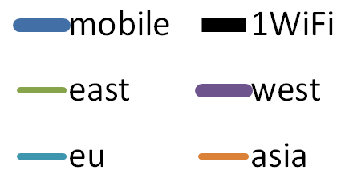
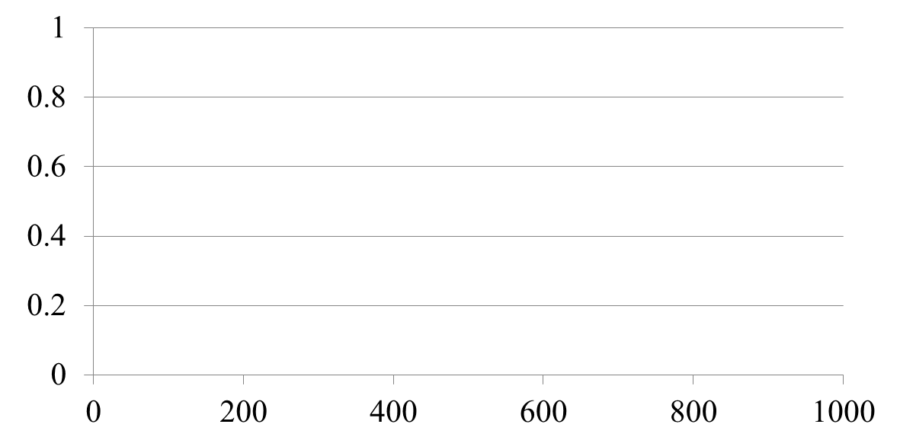
Impact on response time
Augmented Reality
CDF(Cumulative distribution function) of 100 requests in response time
Fraction of response
Time (ms)
Notes:
Since this application employs a low-cost feature extraction algorithm, the processing costs are modest and data transfer costs are relatively high.
Therefore, 1WiFi works extremely well compare to Amazon Cloud and mobile case.

Slide 12
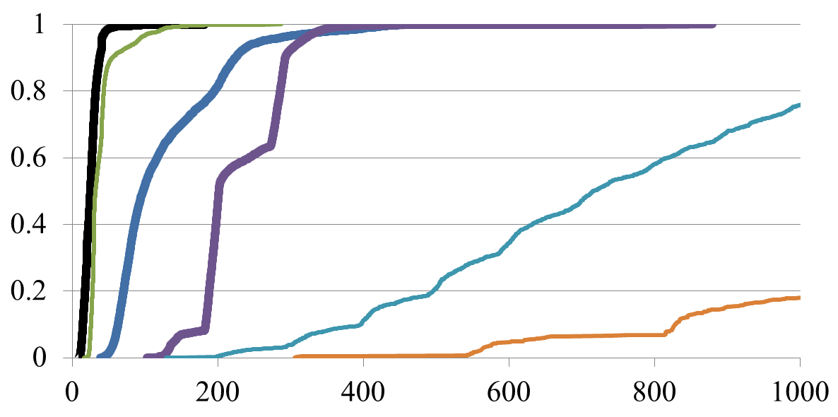
Impact on response time
Fluid Simulation
CDF of 10 minutes simulation
Fraction of response
Time (ms)
* Video available at http://elijah.cs.cmu.edu/demo.html
Notes:
Since this application employs a low-cost feature extraction algorithm, the processing costs are modest and data transfer costs are relatively high.
Therefore, 1WiFi works extremely well compare to Amazon Cloud and mobile case.

Slide 13
Impact on Energy Usage
Energy consumption per query on mobile device
Reduce energy consumption by a factor of 3 in 1WiFi
Offload to far Cloud wastes energy while waiting the response.
* netbook’s baseline idle power dissipation is 10W
Notes:
What about the energy on mobile device?
First we measured average power dissipation for the previous experiment.
As you can see in this table, mobile case requires high power because it has to compute using it process.
And this figure present energy consumption per each query.
Even though cloudlet cases have similar power dissipation, the energy consumption is totally different.
It is mainly because mobile device has to wait for a long time when it uses far cloud like amazon asia.
This means that mobile device has to waste lots of energy while waiting for the result.
If we compare the energy consumption per query between mobile and 1WiFi, we can see that we can reduce energy consumption at least by a factor of 3.
Less clear.
Remote takes long time.
Fluid is a bit different. Other application is done in query face.
Consider FACE application, it takes ~ se.
Mobile device is waiting.
Little different from Fluid.

Slide 14
Effects of Cloud location
Proximity to the data center is essential
Response time & Energy consumption
1WiFi Cloud
The best attainable proximity
The emerging of such applications can be accelerated by deploying infrastructure that assures continuous proximity to the cloud
Contradictory requirements
1WiFi is valuable for mobile computing
However, it needs many data centers at the edges the Internet
Lowers the advantages of consolidation
→ How can we reconcile this conflict?
Notes:
The experimental results confirms that Proximity to the data center is essential for mobile applications.
We thus face contradictory requirements. On the one hand, the 1WiFi property is valuable for mobile computing. On the other hand, it works against consolidation because there have to be many data centers at the edges of the Internet to ensure 1WiFi cloud access everywhere. Consolidation is the essence of cloud computing because dispersion induces diseconomies of scale. How can we reconcile these contradictory requirements?

Slide 15
3. What’s an alternative Cloud architecture?
Hierarchical organization of data center
Level 1
Today’s unmodified Cloud
Level 2
Stateless data centers at the edge
Appliance-like deployment model
Only soft state
Cached virtual machine images
Cached files from DFS
No hard state keeps management overhead low.
Level 1 Data Centers (Amazon EC2)
Internet
Level 2 Data Centers
1WiFi
1WiFi
* soft state is state which can be regenerated or replaced
Notes:
We assert that the only practical solution to this problem is a hierarchical organization of data centers, as shown in Figure
Level 2 consists of stateless data centers at the edges of the Internet, servicing currently-associated mobile devices.
We envision an appliance-like deployment model for Level 2 data centers. They are not actively managed after installation. Instead, soft state (such as virtual machine images and files from a distributed file system) is cached on their local storage from Level 1 data centers.

Slide 16
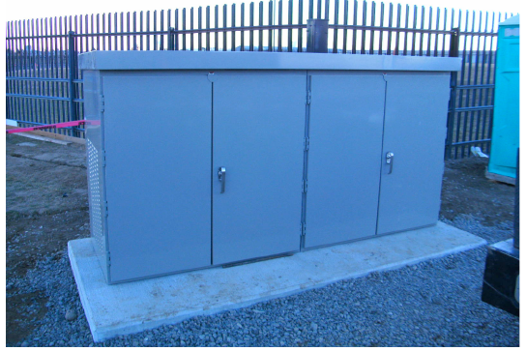
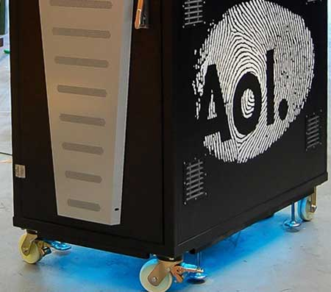
3. Alternative Cloud Architecture
Physical realization
Hardware technology is already out today
Repurpose as Level 2 data center by removing hard state and adding self-provisioning
Myoonet’s Outdoor micro data center [2]
AOL’s micro data center [3]
Notes:
Myoonet and AOL introduced indoor micro data centers for enterprises. Today these are being used as Level 1 data center in private clouds.
By removing hard state and adding self-provisioning, they can be repurposed as Level 2 data centers.
In the future, one can envision optimized Level 2 data centers for 1WiFi. For example, with modest engineering effort, a WiFi access point could be transformed into a “nano,” “pico,” or “femto” Level 2 data center by adding processing, memory and storage.

Slide 17
3. Alternative Cloud Architecture
Operating Environment
Commonalities in the requirement between Levels 1 and 2
Strong isolation between untrusted user-level computations
Mechanisms for authentications, access control and metering
Dynamic resource allocation
The ability to support a wide range of user-level computations
Virtual machine as Cloud of today like EC2

Slide 18
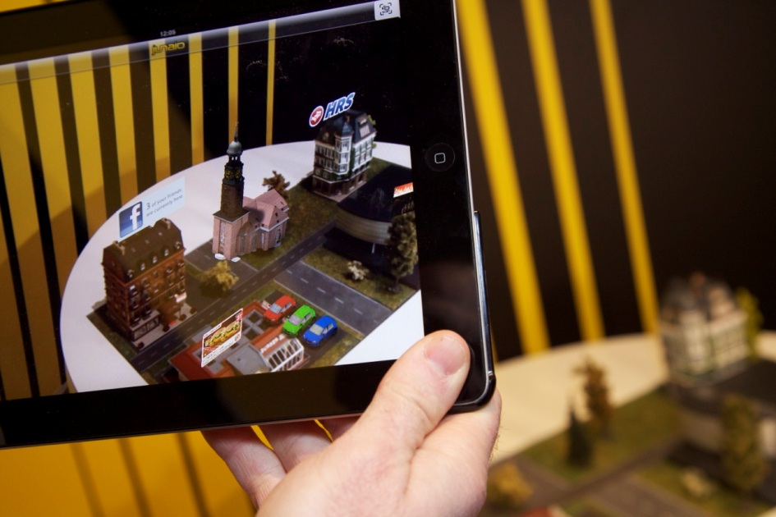
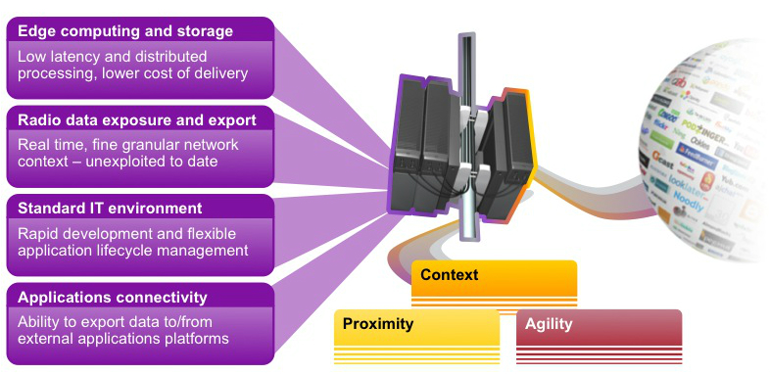
Industrial efforts for 1WiFi Cloud
Nokia Siemens Networks and IBM
Announced Liquid Applications at MWC 2013
Deploys the cloud into the (cellular) base station
“Improved latency can enable high-value vertical solutions“..
Notes:
industry also start looking at this problem and start building their solution.
The approach is not exactly same but they also care about similar mobile application

Slide 19
Discussion & Future work
Rapid Provisioning
Provisioning delay directly impact usability*
Discovery
How to dynamically find the right Level 2 data center?
Data placement
Appropriate data placement is important for many “Cloud” applications
Two extreme ends
Application with relatively small data set for its operation
A very large data set accessed in an unpredictable manner
Most applications likely fall between the two ends
Map Data: physical location is highly correlated with accessed data map
Automatic caching of distributed file system exploiting locality information
* Kiryong Ha et al. "Just-in-Time Provisioning for Cyber Foraging", In MobiSys 2013 (to appear)

Slide 20
Conclusion
Do we really need to offload?
Cloud offload is here to stay
What’s the effect of Cloud location?
Emerging mobile applications endanger cloud consolidation
In situation where public Clouds are inadequate, what would be an alternative Cloud architecture?
Hierarchical solution is desirable and feasible

Slide 21
Reference
A. Li, X. Yang, S. Kandula, and M. Zhang, “Cloudcmp: comparing public cloud providers,” in Proceedings of the 10th annual conference on Internet measurement. ACM, 2010, pp. 1–14.
Myoonet, “Unique Scalable Data Centers,” December 2011, http://www.myoonet.com/unique.html.
R. Miller, “AOL Brings Micro Data Center Indoors, Adds Wheels,” http://www.datacenterknowledge.com/archives/2012/08/13/aol-brings-micro-data-center-indoors-adds-wheels , August 2012.
Kiryong Ha, Padmanabhan Pillai, Wolfgang Richter, Yoshihisa Abe, Mahadev Satyanarayanan, "Just-in-Time Provisioning for Cyber Foraging", In MobiSys 2013 (to appear)
D. Kucera, “Amazon apologizes for Christmas Eve outage affecting Netflix,” December 2012, http://articles.washingtonpost.com/2012-12-31/business/361036071amazon-web-services-christmas-eve-outage-largest-online-retailer
M. Satyanarayanan, “The Evolution of Coda,” ACM Transactions on Computer Systems, vol. 20, no. 2, May 2002.
S. Rhea, P. Eaton, D. Geels, H. Weatherspoon, B. Zhao, and J. Kubiatowicz, “Pond: the oceanstore prototype,” in Proceedings of the 2nd USENIX Conference on File and Storage Technologies, 2003,pp. 1–14.

Slide 23
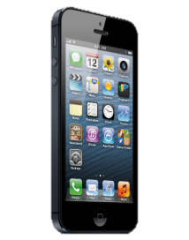
Scaling out 1WiFi
Provisioning a Level 2 data center
Level 2 needs to be agile in provisioning
Provisioning delay impacts usability
Approaches
Pre-provisioning exploiting hints of user’s mobility
Synthesize the desired VM (disk + memory) combining pre-cached Base VM and overlay [4]
Base VM: Vanilla OS with kernel and basic library
Overlay : A binary patch containing customized part
Level 1 Data Centers
Overlay VM (Provisioned)
Internet
Level 2 Data Center (1WiFi)
Custom VM
Base VM (Pre-cached)
Overlay VM (Provisioned)
Notes:
Level 1 is optimized for launching existing VM images
One must launch existing VM and laboriously modify it to make a custom environment
Or suffer long & tedious upload of custom image

Slide 24
Supplement
Local speed to compare Cloudlet and Amazon machine
 | Object (300 image) | FACE (300 image) | SPEECH (100 sentence)
Cloudlet | 902.30 s | 130.88 s | 913.25 s
US-East | 566.36 s | 98.67 s | 235.36 s

Slide 25
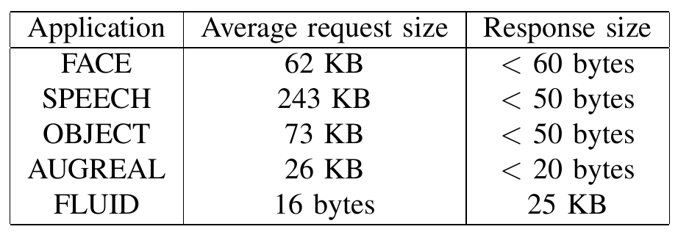
Supplement
Average request & response size of each application

Slide 26
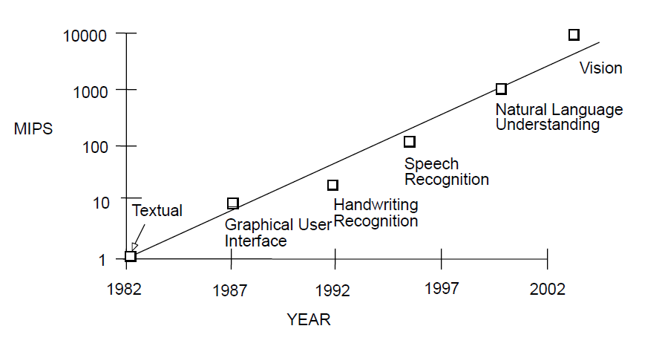
Supplement Do We Really Need to Offload?

Slide 27
Applications Details
FACE
Detects faces in an image, and attempts to identify the face from a prepopulated database.
Haar Cascade of classifiers to do the detection, and then uses the Eigenfaces method [50] based on principal component analysis (PCA) to make an identification.
Implemented with OpenCV at Microsoft Windows environment.
Developed by CMU SEI Group.
Training the classifiers and populating the database are done offline, so our experiments only consider the execution time of the recognition task on a pre-trained system.

Slide 28
Applications Details
Speech Recognition (SPEECH)
Implemented based on a well-studied, open-source speech-to-text framework based on Hidden Markov Model (HMM) recognition systems [45].
It takes as input digitized audio of a spoken English sentence, and attempts to extract all of the words in plain text format.
Single-threaded, and since it is written in Java, it can run on both Linux and Microsoft Windows

Slide 29
Applications Details
Object and Pose Identification (OBJECT)
It identifies known objects, and importantly, also recognizes the position and orientation of the objects relative to the user.
It extracts key visual elements (SIFT features [31]) from an image, matches these against a database of features from a known set of objects, and finally performs geometric computations to determine the pose of the identified object.
The implementation runs on Linux, and makes use of multiple cores and GPUs, if available.
The database is populated with thousands of features extracted from more than 500 images of 13 different objects.
Developed by CMU RI

Slide 30
Applications Details
Mobile Augmented Reality (AUGREAL)
It uses computer vision to identify actual buildings and landmarks in a give image, and label them precisely in the view [48].
The prototype application uses a dataset of 1005 labeled images of 200 buildings as the relevant database slice.
It runs on Microsoft Windows, and makes significant use of OpenCV libraries [35], Intel Performance Primitives (IPP) libraries, and multiple processing threads.
Developed by Intel Research

Slide 31
Applications Details
Physical Simulation and Rendering (FLUID)
Using accelerometer readings from a mobile device as input parameters, it physically models the motion of imaginary fluids with which the user can interact.
The application has a backend that runs a physics simulation, based on the predictive corrective incompressible smoothed particles hydrodynamics (PCISPH) method [44].
The front end (mobile device) renders an image of the fluid using these particle positions.
It is implemented as a multithreaded application on top of Linux. In our experiments, it simulates a 2218 particle system representing a liquid in a container. The simulation uses 20 ms timesteps, so it can generate up to 50 frames per second

Slide 32
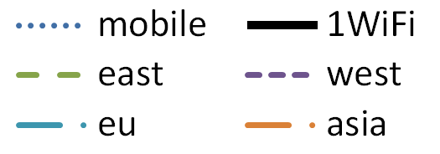
Impact on response time
Face Recognition
(Zoom-out to 5 seconds)
(ms)

Slide 33
Impact on response time
Speech Recognition
CDF of 500 requests (500 WAV files)
Each recording is one English sentence
(ms)

Slide 34
Impact on response time
Object Recognition
CDF of 300 requests (300 images)
(ms)

Slide 35
Impact on Energy Usage
Energy usage at mobile device
Power dissipation in watts, averaged over the whole experiment
Energy consumed per query (or frame)
 |  | Mobile | 1WiFi | East | West | EU | Asia
FACE | (W) | 14.8 | 12.6 | 11.4 | 10.9 | 11.0 | 11.0
 | (J/query) | 16.4 | 5.4 | 6.6 | 8.5 | 9.5 | 14.3
SPEECH | (W) | 16.1 | 14.5 | 14.5 | 14.4 | 14.4 | 14.4
 | (J/query) | 22.5 | 8.2 | 5.3 | 11.2 | 12.2 | 26.9
OBJECT | (W) | 16.8 | 14.5 | 14.5 | 14.6 | 14.5 | 14.5
 | (J/query) | 107.0 | 48.2 | 28.9 | 41.5 | 35.3 | 43.8
AUGREAL | (W) | 13.9 | 11.7 | 11.3 | 11.7 | 11.3 | 11.3
 | (J/query) | 3.3 | 1.1 | 3.1 | 5.1 | 5.2 | 9.4
FLUID | (W) | 17.0 | 15.8 | 15.9 | 15.8 | 15.8 | 15.7
 | (J/query) | 1.9 | 0.3 | 0.4 | 1.8 | 4.6 | 10.7

Slide 36
Impact on response time
Fluid Simulation
Response time
From transmission of a user action (Accelerometer) to the return of the result that input is reflected.
Local execution on the mobile device
good response time. But cannot execute simulation steps fast enough.
Demo
Server keeps generating up to 50 FPS and changes states of simulation according to received ACC
http://elijah.cs.cmu.edu/demo.html
Location | FPS
Mobile | 9.15
Cloudlet | 49.76
EC2 East | 42.78
EC2 West | 10.31
EC2 EU | 3.59
EC2 Asia | 1.55

Slide 37
Data Transmission Model
Send a, y-axis accelerometer data (2 floats)
Receive every particle’s location (2 floats) and pressure information (1 integer)
Request-response
Continuous Transmission
Mobile (client)
Cloudlet (server)
Mobile (client)
Cloudlet (server)
Acc (x, y)
Acc_#1
Position
Compute
Compute
Position
Return with Acc_#1

Slide 38
Data Transmission
Token based transmission
Server sends only when it gets acknowledgement from client
Utilize more bandwidth without queuing delay
Mobile (client)
Cloudlet (server)
ACC
Token #1
20 ms
20 ms
ACC (Ack #1)
Token #2
Send only when (Token# - Ack#) < Queue_Length
ACC (Ack #2)

Slide 39
Data Transmission – Amazon Asia
Mobile (client)
Cloudlet (server)
High latency(250+ ms) & Good Bandwidth(300 kbps)
Latency limits up to 4 FPS
Bandwidth limits up to 8 FPS
ACC
#1
20 ms
#2
Ack #1
#3
Queue Length: 2

Slide 40
Data Transmission – Cloudlet
Mobile (client)
Cloudlet (server)
Low latency(10ms) & High Bandwidth(30 Mbps)
Latency limits up to 100 FPS
Bandwidth limits up to 1000 FPS
20 ms
ACC
#1
ACK #1
#2
ACK #2

Slide 41
Supplement
Human takes 370 ~ 620 ms to recognize face
For comparison, recent experimental results on human subjects by Ramon et al. [22] show that recognition times under controlled conditions range from 370 milliseconds for the fastest responses on familiar faces to 620 milliseconds for the slowest response on an unfamiliar face. Lewis et al. [23] report that human subjects take less than 700 milliseconds to determine theabsence of faces in a scene, even under hostile conditions such as low lighting and deliberately distorted optics.
Agus et al. [21] report that human subjects recognize short target phrases within 300 to 450 ms, and are able to tell that a sound is a human voice within a mere 4 ms

Slide 42
Supplement
Average power dissipation

